Slide 1
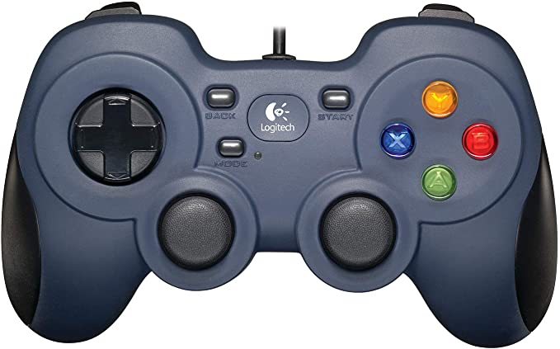

Slide 2
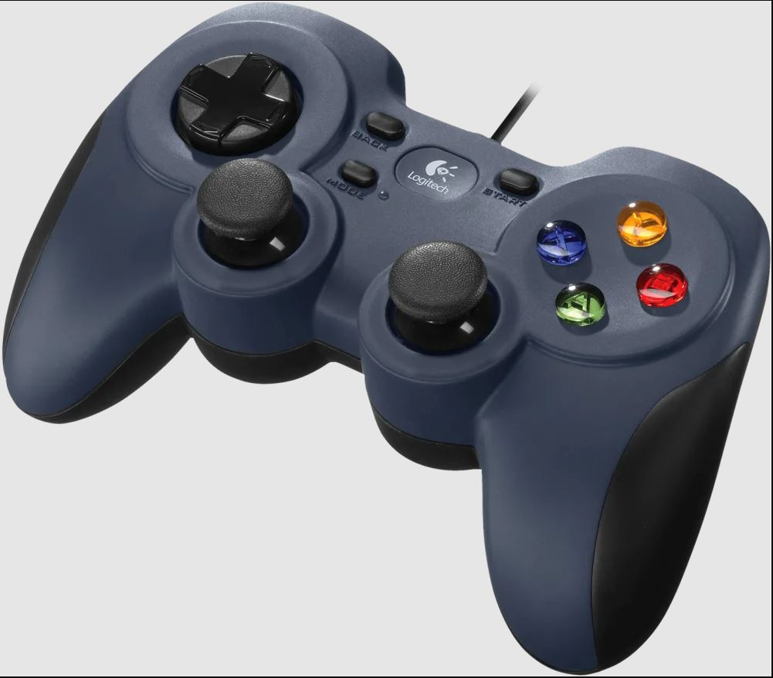

Slide 3
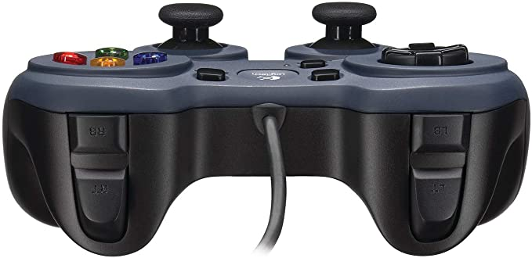

Slide 4
OPERATOR
Shooter
Intake Arm UP
Intake Motor
Intake Arm DOWN
Transfer Release
Intake Motor with increased speed
Intake Reverse
Spring Arms
Climb Arms

Slide 5
DRIVER
Stop Recording Auto
Start Recording Auto
Pivot Right
Pivot Left
Load Pipeline 0
Load Pipeline 1
Set Limelight to Vision
Limelight LED ON
Limelight LED OFF
Set Limelight to Camera Mode
Start Driving with Limelight
Y Throttle
move
X Wheel Steering
Stop Driving with Limelight

Slide 6
Button 5
Button 4
Button 7
Button 6
Button 8
Button 9
Button 0
Button 3
Button 2
Button 1
Joystick Axis 0
Joystick Axis 2
Joystick Left Button 10
Joystick Axis 1
Joystick Axis 3
Joystick Right Button 11

Slide 7
Button 5
Button 4
Button 7
Button 6
Button 8
Button 9
Button 0
Button 3
Button 2
Button 1
Joystick Axis 0
Joystick Axis 2
Joystick Left Button 10
Joystick Axis 1
Joystick Axis 3
Joystick Right Button 11

Slide 8
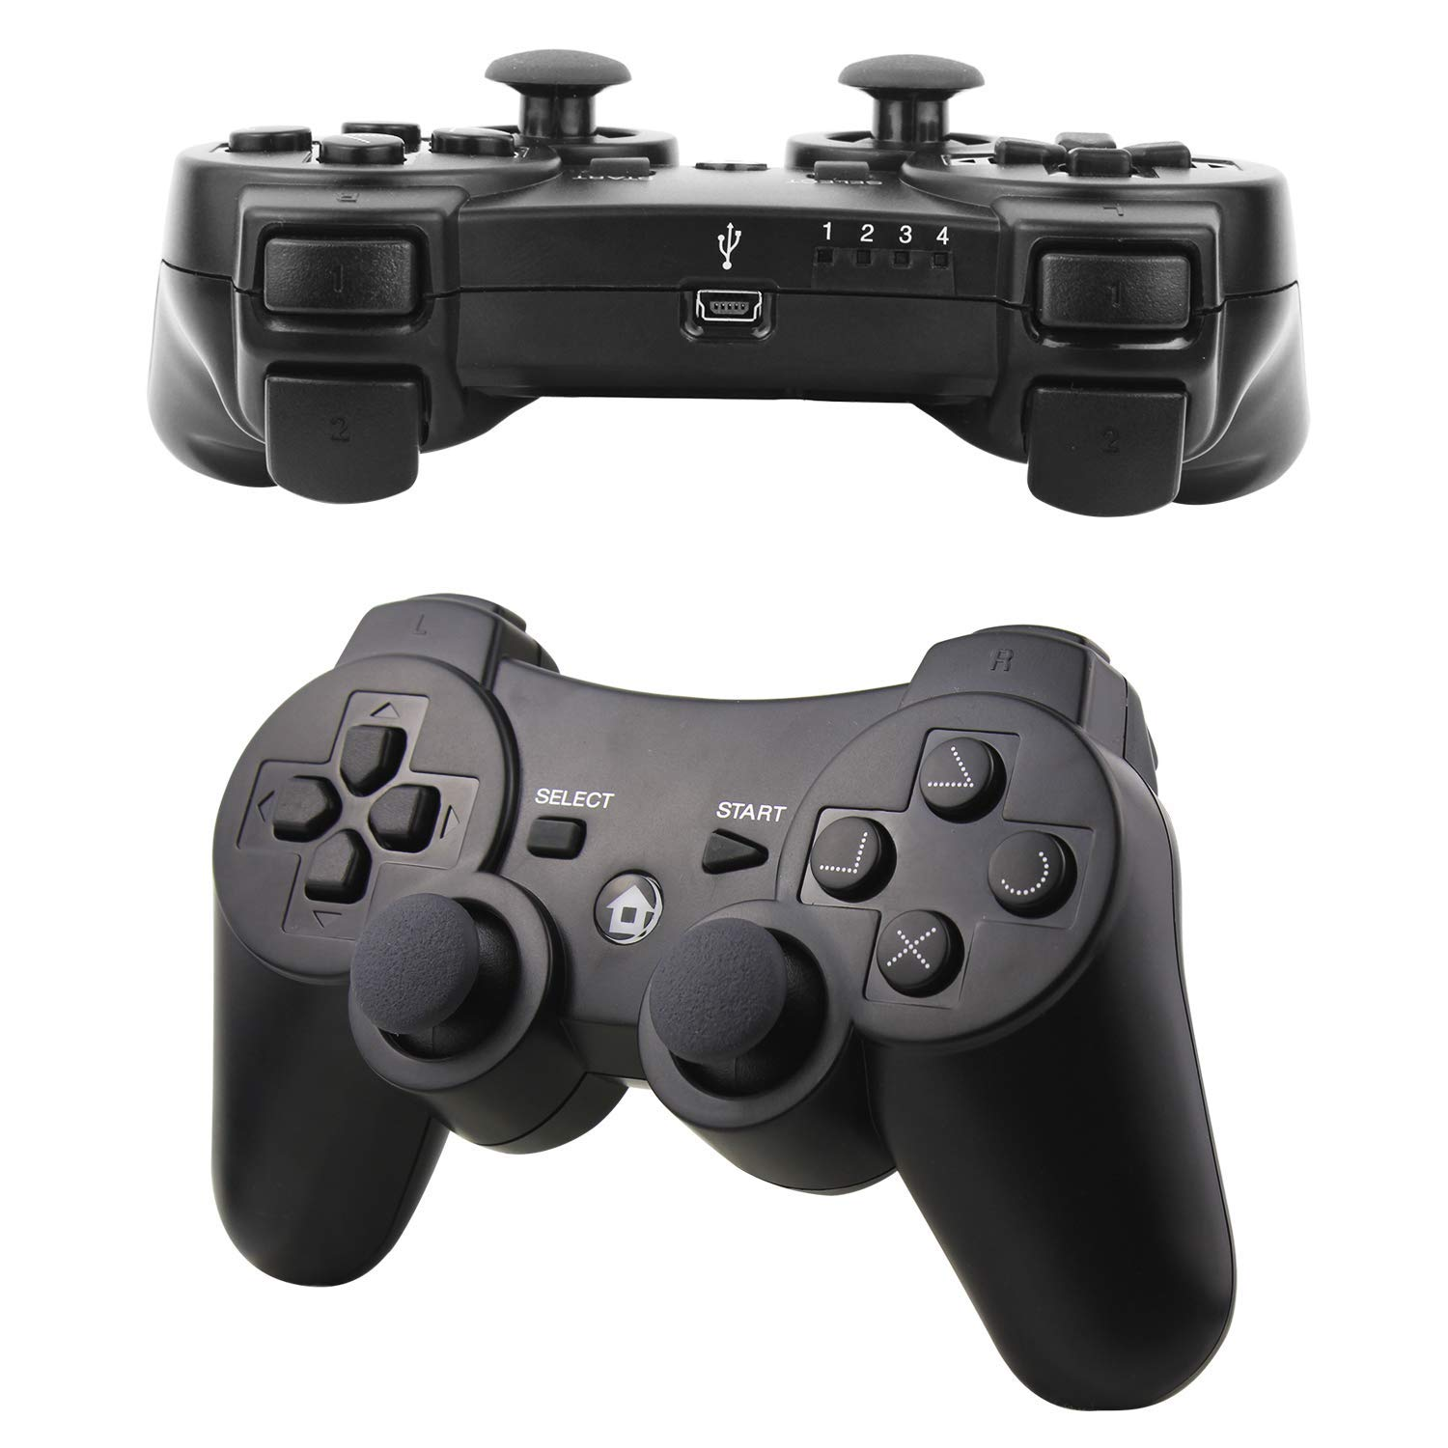

Slide 9
DRIVER
Retract hook, lift robot –
Left Front Button
Deploy hook – Right front button
Right Pivot – Right front trigger
Limelight
LED OFF
Drive
Camera
Limelight
LED ON
Drive to
Target
Pivot left - Left front trigger
Limelight driving
Deploy hook safety
Left Joystick Push Down
Drive with full power
Not used
Intake Arm up
Right Joystick 2 Turn
Left Joystick Speed
Right Joystick Push Down
Pivot with extra power

Slide 10
OPERATOR
Intake / Lower arm –
Left Front Button
Shooter– Right front button
Limelight LED ON
Transfer to shooter –
Right front trigger
Transfer stuck - Left front trigger
Control Panel 3 turns
Climb motor safety
Left Joystick Push Down
Shoot to the low target
Control Panel Color Match
Intake Arm up
Limelight LED OFF
Right Joystick Push Down
Reverse the intake wheels
Climb motor - Left Joystick 1

Slide 11
Button 4
Button 5
Button 6
Button 7
Button 0
Button 1
Button 3
Left Joystick 0
Right Joystick 2
Button 2
Left Joystick 1
Right Joystick 4

